Slide 1

EHR Governance
Aug 2026
Notes:
OPEN THE SESSION (2 min).
Say: this is a governance training, not an OpenMRS feature demo. By the end you must be able to teach four things to your own teams: what you may decide locally, what must be approved nationally, what is prohibited outright, and what evidence you must keep.
Set the tone early: almost every governance failure we will look at today was committed by a competent person trying to be helpful and fast. Governance is not about distrust — it is about traceability.
Housekeeping: 3 hours, one 10-minute break after Module 3. Ask participants to note their single biggest 'grey area' on a card now; you will return to those cards at the close.

Slide 2
Content Outline
01
EHR Governance
02
Legal and other documentations
03
Governance Structure
04
Clinical workflow
05
Data Roles
06
Implementation Steps
07
Risk
08
Cases, conduct and cascade
Notes:
AGENDA (2 min).
Walk the eight modules quickly. Flag that Modules 2, 5 and 6 carry the highest density of decisions implementers get wrong in practice.
Announce the break position now so nobody drifts out during Module 3, which carries the legal citations.
If the group is largely new to the platform, borrow 5 minutes from Module 7 and give it to Module 2.

Slide 3
EHR Governance
EHR governance is the formal framework for deciding, approving, implementing, monitoring, and enforcing how an EHR is designed, configured, used, secured, shared, supported, and continuously improved, with clear accountability, transparency, and traceability.
Module 1 · Foundations of EHR Governance
5
Notes:
CORE DEFINITION (5 min).
This slide is the spine of the whole session. Everything later is an instance of decisions, controls, evidence.
ASK: 'What is the difference between EHR governance and EHR administration?' — this is also question 1 of the post-test, so plant it here. Expected answer on the red callout.
Emphasise evidence hardest. Most participants accept decision rights in principle and still fail on evidence: they get verbal approval on a phone call, do the work correctly, and leave no record. Tell them plainly: from a compliance audit's point of view, that is indistinguishable from an unauthorised change.

Slide 4
Guiding Principle
01
Patient primacy
02
One patient, one record
03
National ownership, local stewardship
04
Standards-based customisation
05
Tenant isolation
06
Equity and inclusion
07
Security and privacy
08
Accountability and transparency
09
Ownership and sustainability
Does it protect the patient? Does it preserve one record? Does it hold the national standard? Does it protect privacy? Does it keep the system sustainable?
Notes:
AGENDA (2 min).
Walk the eight modules quickly. Flag that Modules 2, 5 and 6 carry the highest density of decisions implementers get wrong in practice.
Announce the break position now so nobody drifts out during Module 3, which carries the legal citations.
If the group is largely new to the platform, borrow 5 minutes from Module 7 and give it to Module 2.

Slide 5
Legal and Other Governance doc alignment
Legal
Other Governance doc
Personal Data Protection Proclamation No. 1321/2024 - Requires EHR implementers to establish a lawful basis for access, security, retention, correction, disclosure, and data sharing
Health Service Administration and Regulation Proclamation No. 1362/2024- health information management, record keeping, quality assurance and accountability.
Critical Infrastructure Cybersecurity Proclamation No. 1426/2026 - access control, risk assessment, secure configuration, auditability, resilience, backup/recovery, and incident management mandatory governance considerations
Digital Ethiopia 2030: Requires the EHR implementation to support national digital-transformation priorities, trusted digital services, shared digital infrastructure, inclusion, interoperability, and long-term national ownership.
Standards for Electronic Health Records in Ethiopia
EHR Governance Framework
Personal Data any information relating to an identified or identifiable natural person who can be identified , directly or indirectly , in particular by reference to an identifier such as a name, an identification number, location data , an online identifier or to one or more factors specific to the physical, physiological , genetic , mental , economic , cultural or social identity of that natural person;
Notes:
RBAC AND PAM (7 min).
The line participants most often cross: 'tenant administrators may assign standard roles but may not create roles or alter role-permission mappings'. Facility administrators frequently invent a role to solve a workflow problem. That is an unauthorised change to a platform-governance artifact.
Second-approver actions deserve emphasis — read the four aloud. If a participant can perform any of them alone today, that is a finding to escalate.
ASK: 'What must happen before remote support is allowed?' — post-test question. Answer: prior documented approval, time-boxing, named attribution, session logging, post-session review.

Slide 6
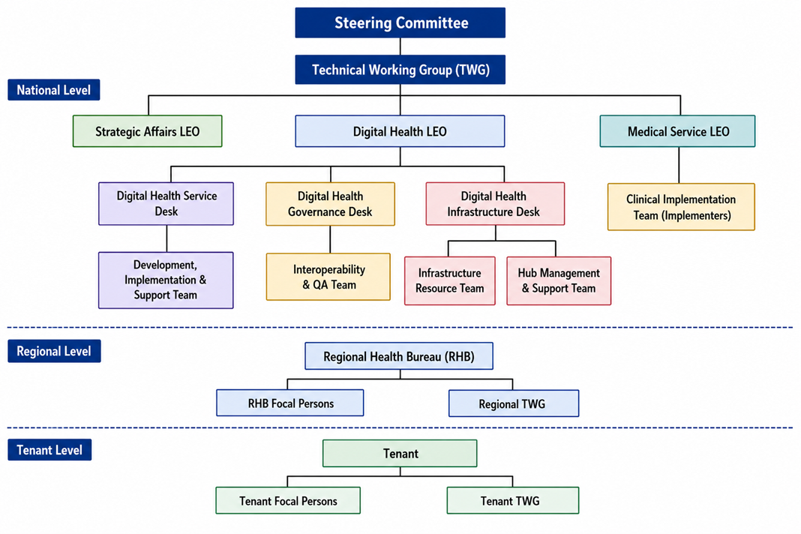
Overall EHR Governance Structure
Notes:
RBAC AND PAM (7 min).
The line participants most often cross: 'tenant administrators may assign standard roles but may not create roles or alter role-permission mappings'. Facility administrators frequently invent a role to solve a workflow problem. That is an unauthorised change to a platform-governance artifact.
Second-approver actions deserve emphasis — read the four aloud. If a participant can perform any of them alone today, that is a finding to escalate.
ASK: 'What must happen before remote support is allowed?' — post-test question. Answer: prior documented approval, time-boxing, named attribution, session logging, post-session review.

Slide 7
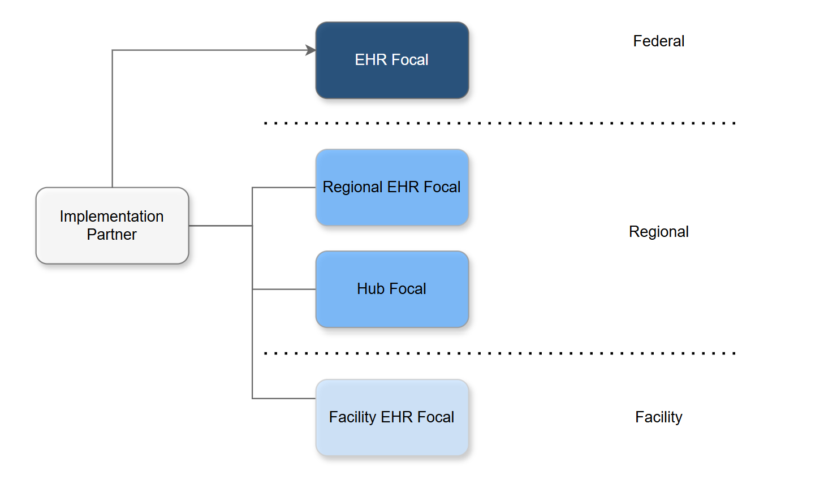
Implementation Governance Structure

Slide 8
Clinical content Governance
Nationally fixed
Facility Level Configuration
Clinical Workflow
Mandatory facility level forms
Standard terminologies
Role-permission mappings
Available services
Price configuration
User assignment
Survey and campaign related forms
Notes:
BOUNDARIES (6 min).
Run this as a sorting exercise. Read out eight configuration items from the participants' own implementation and have the room place each in one of the three columns. Expect disagreement on 'local reporting views' and 'user assignment to roles' — both are permitted, but only within approved roles and approved data scopes.
The right-hand column is not a list of bad practices — it is a list of items that require approval. Reframe it that way: the answer to a prohibited item is a request, not a refusal.
Emphasise the final clause of the callout: a change without a rollback procedure has not met the approval standard.

Slide 9
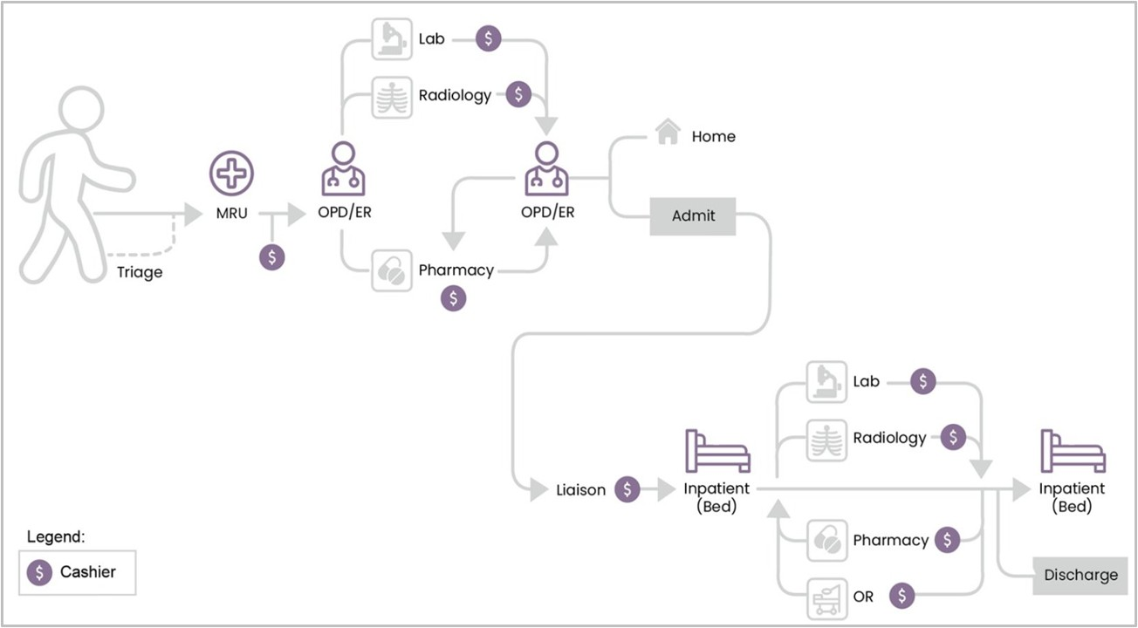
Clinical Workflow
Notes:
CLINICAL GOVERNANCE (6 min).
The red-line panel deserves the most time. Take the last one — live data in training environments — and dwell on it: it is the most frequently violated rule in every EHR rollout, and it is a data-protection breach, not a shortcut.
For clinicians in the room, connect approval requirements to their own professional accountability: an unvalidated CDS rule that fires wrongly is attributable to whoever approved it.
ASK: 'A senior consultant asks you to add a field before tomorrow's clinic. What do you do?' Correct answer: log the request, route it to the clinical content pathway, explain the timeline, and do not touch production. Being unpopular for a week is cheaper than an unversioned national form.

Slide 10
Data roles
1
1
Data subject - patient
2
Data controller
3
Data processor
The individual to whom the personal data relates and who holds rights regarding its processing.
The institution determining purpose, scope, means and lawful basis for processing the Ministry, RHBs, facilities and other authorised bodies.
Processes data only on behalf of an authorised controller, under a documented agreement
Data custodian
5
Data steward
6
Data user
4
Technical custody: secure storage, protection, backup, recovery, access enforcement, availability and operational safeguarding.
An authorized person who accesses or uses data only for an approved role, purpose and level of access.
Uses data strictly within role, facility, service area and authorised purpose - the boundary that break-glass exists to handle lawfully.
One Patient, One Record
Notes:
DATA ROLES (5 min).
Have each participant say aloud which role they occupy — most will hesitate between processor and custodian, which is fine: many implementers are both, and both obligations apply.
The trap to expose: a partner who has been asked by a programme or donor for 'just an extract for analysis'. As a processor they have no authority to agree, however senior the requester. That decision belongs to the controller through the Governance Desk process, with Legal Service consulted.
Have the room read the cascade sentence aloud together. It sounds theatrical; it works.

Slide 11
Implementation Steps
EHR Configuration
ToT Training
End-User Training
Testing
EHR Champions selection
EHR Focal Selection
Implementation Plan
User Access
Go-live
Facility Assigned
Readiness Assessment
  Infrastructure
  Facility Level Requirement
Network Installation
Clinical Workflow
Standardizing clinical workflow
Notes:
RBAC AND PAM (7 min).
The line participants most often cross: 'tenant administrators may assign standard roles but may not create roles or alter role-permission mappings'. Facility administrators frequently invent a role to solve a workflow problem. That is an unauthorised change to a platform-governance artifact.
Second-approver actions deserve emphasis — read the four aloud. If a participant can perform any of them alone today, that is a finding to escalate.
ASK: 'What must happen before remote support is allowed?' — post-test question. Answer: prior documented approval, time-boxing, named attribution, session logging, post-session review.

Slide 12
Risk | Potential Impact | Mitigation / Required Control
Facility not ready for implementation | Delayed deployment | Complete readiness assessment (verify power, LAN, connectivity, devices, server environment, backup and downtime capability)
Unauthorised configuration or customization | National workflow divergence | Configure only within approved facility-level parameters. Changes affecting national workflows, forms, terminology, roles or core functionality must follow the formal change-control and approval process.
Incorrect or excessive user access | Privacy breach, unauthorized clinical actions and loss of accountability | Use approved role-permission mappings, named individual accounts and least privilege. No shared credentials. Validate user lists and temporary access for users that are not registered in iHRIS
Insufficient user readiness and adoption | Incorrect use, workarounds, poor data quality and rejection of the EHR | Complete end-user training, hands-on training, identify EHR champions/focal persons, validate competency and provide structured go-live
Weak incident and support management | Prolonged outages, unresolved problems and uncontrolled local fixes | Use the approved escalation path; classify severity, open tickets, document actions and comply with response/resolution targets.
Improper handling of patient data | Confidentiality breach, legal exposure and loss of public trust | Use only authorised data access; no production patient data for training/testing; use synthetic or de-identified data; personal-device storage and unapproved sharing.
Poor handover and dependency on the Implementation Partner | Facility cannot sustain operations after partner exit | Maintain documentation; transfer knowledge to facility/hub teams; complete signed handover

Slide 13
Thank you !
Aug 2026
Notes:
OPEN THE SESSION (2 min).
Say: this is a governance training, not an OpenMRS feature demo. By the end you must be able to teach four things to your own teams: what you may decide locally, what must be approved nationally, what is prohibited outright, and what evidence you must keep.
Set the tone early: almost every governance failure we will look at today was committed by a competent person trying to be helpful and fast. Governance is not about distrust — it is about traceability.
Housekeeping: 3 hours, one 10-minute break after Module 3. Ask participants to note their single biggest 'grey area' on a card now; you will return to those cards at the close.

